Slide 1
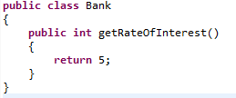
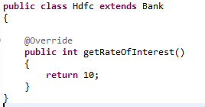
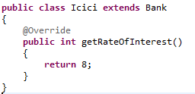
Method Overriding
Bank is a class that provides functionality to get rate of interest. But, rate of interest varies according to banks. For example, HDFC and ICICI banks could provide 10% and 8% rate of interest.
extends
extends

